Slide 1
Learning How to Study the Bible
Bible Study Methods - 1

Slide 2
Bible Study Methods - 1
Devotional Studies
Psalm 19:1-4
Psalm 139:1-14
Romans 10:1-3

Slide 3
Bible Study Methods
Example page taken from a book called,
“The Five Minute Bible Study for Men”
Mornings in God’s Word
Danger: Many of these books steeped in denominational error.

Slide 4
Bible Study Methods - 1
Historical and Geographical Studies
Serve to establish context
Can be evidentiary in nature
Limitation: Ancillary to purpose of knowing God’s will.

Slide 5
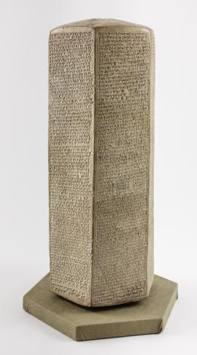
Sennacherib’s Prism
"As for the king of Judah, Hezekiah, who had not submitted to my authority, I besieged and captured forty-six of his fortified cities, along with many smaller towns, taken in battle with my battering rams. ... I took as plunder 200,150 people, both small and great, male and female, along with a great number of animals including horses, mules, donkeys, camels, oxen, and sheep. As for Hezekiah, I shut him up like a caged bird in his royal city of Jerusalem. I then constructed a series of fortresses around him, and I did not allow anyone to come out of the city gates. His towns which I captured I gave to the kings of Ashod, Ekron, and Gaza."
2 Kings 19

Slide 6
Bible Study Methods - 1
Character Studies
Hebrews 11 – 12:2
Acts 5:5,11

Slide 7
Character Study – Saul of Tarsis
Bad Characteristics
Good Characteristics
Persecutor of Christians (Acts 8:3)
Zeal without knowledge (Romans 10:1-3)
Acted on a good conscience (Acts 23:1)
When presented with truth, accepted it and repented (Acts 9:6)

Slide 8
Bible Study Methods - 1
Topical Studies
Take a particular topic (ex: Love, Grace, Obedience, etc.)
A topical Bible like Nave’s is helpful
Study the verses related to the topic

Slide 9
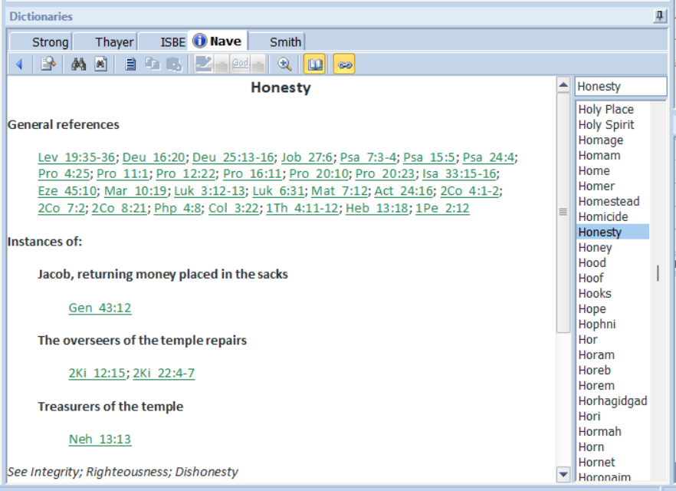
Example Topic Honesty
This screen capture taken from the Bible program, E-Sword.

Slide 10
Exercise for Class – Lot (Genesis 13:1-13; 19)
Negative Characteristic/Action
Positive Characteristic/Action
Allowed himself to get drunk, leading to incest (19:33,35)
Ephesians 5:18
Believed God’s words of judgment against Sodom and Gomorrah (19:12-14)
2 Peter 3:3-4

